Slide 1
Medical Report Summarizer
Winta Yoseph, Kacie Do
Group #13
DTSC 4050
Instructor: Dr. Yang Zhang

Slide 2
Table of Contents:
Introduction
Example of Medical Report
Goal
Existing Methodologies
Current Limitations
Proposed Methodology I: TextRank
Problem 1: Unstructured Data
Problem 2: Predetermined Keywords
Workflow
Benefits of Using TextRank
Assessing Model Performance: TextRank
Results (Generated Summaries)
ROUGE Evaluation Model
Average ROUGE Scores
Visualization of Average Scores
Precision Score Analysis
Recall Score Analysis
F1 Score Analysis
Results (NER) Scispacy
Evaluate Model Scispacy
Limitations
Proposed Methodology II: Scispacy
Problem 3: Lack of Domain Specific Awareness
Findings
Conclusion
References

Slide 3
Introduction:
Domain: Data science and Natural Language Processing (NLP) in healthcare settings
Background:
Patient medical reports are often too long and complex which can delay medical diagnosis and treatment. The average physician spends approximately 16 minutes and 14 seconds reviewing Electronic Health Records (EHRs) for each patient. This does not take into account the time spent updating medical records.
Medical reports are subject to human errors such as typos. Because of this, healthcare professionals spend a lot of time trying to understand and confirm the contents of medical reports written by their colleagues. This can lead to misinterpretation which can compromise their ability to deliver quality healthcare.
Depending on the health concern, the amount of time it takes to view and fully comprehend medical records can significantly impact patient outcomes.

Slide 4
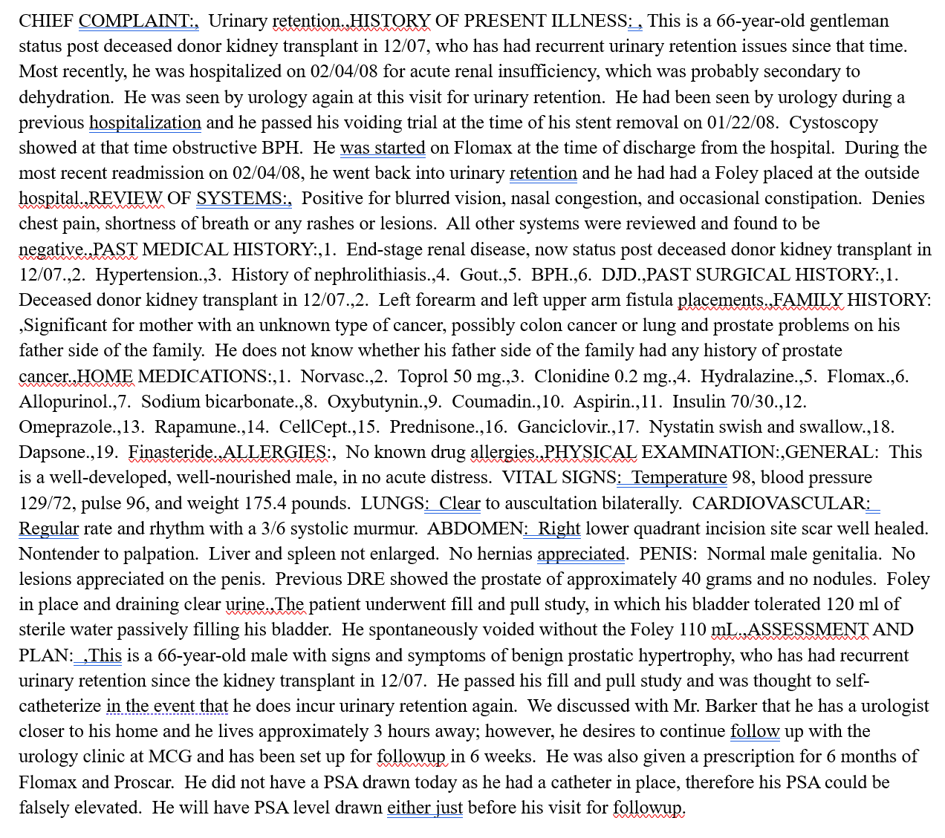
Example of Medical Report
Source: Kaggle.com and MTSamples.com - collected by medical transcriptionists for reference purposes

Slide 5

GOAL:
Create a program that uses Natural Language Processing to summarize medical reports and detect biomedical terms which will help accelerate the everyday functions within healthcare facilities

Slide 6
Existing Methodologies:
Epic Systems:
Generative AI implemented into electronic health record (EHR) system
Follows HIPAA regulations
IBM Health Report Assistant:
A database that allows healthcare professionals to upload and store medical reports
Transforms complex medical reports into summaries that can be easily interpreted by both patients and healthcare workers
Includes a chatbot that patients can use to ask questions regarding their health and/or treatment
Amazon Comprehend Medical:
Uses Natural Language Processing (NLP) to extract text from complex medical records and create simplified summaries to expedite healthcare and medical insurance processes

Slide 7
Current Limitations:
Problem 1: NLP does not work well with unstructured medical report data or free text
Problem 2: Some NLP’s are limited to predetermined keywords
Problem 3: Lack of domain-specific awareness

Slide 8
Proposed Methodology:
I. TextRank
II. Scispacy

Slide 9
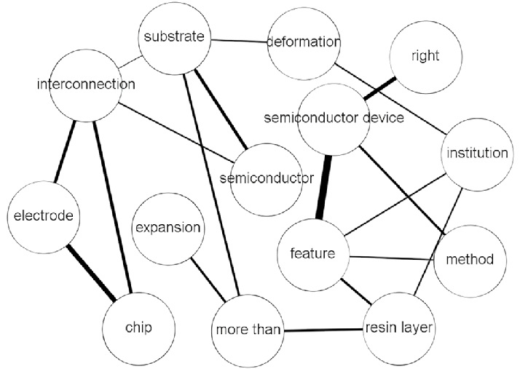
Proposed Methodology:
I. TextRank
A graph based ranking algorithm
Work by analyzing the relationships between words or phrases
Aimed at creating concise summaries without needing predefined keywords
The implementation of classic TextRank model
Source: A patent keywords extraction method using TextRank model with prior public knowledge - Scientific Figure on ResearchGate. Available from: https://www.researchgate.net/figure/An-example-of-patent-TextRank-network_fig2_350472445 [accessed 29 Apr 2025]

Slide 10
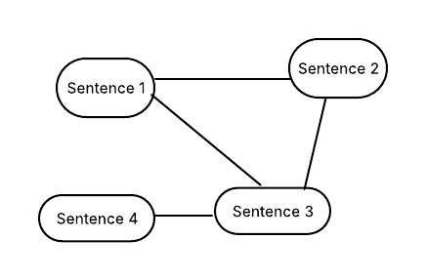
Problem 1: Unstructured data
How TextRank addresses?
Graph-based Structure
Contextual relevance
Relies on word relationships rather than needing structured input
Node = sentence
Edge = cosine similarity
Visualization of TextRank in this project

Slide 11
Problem 2: Predetermined keywords
How TextRank helps?
No need for predefined vocabulary
Finds most important sentences based on the context
Better for free-text medical report

Slide 12
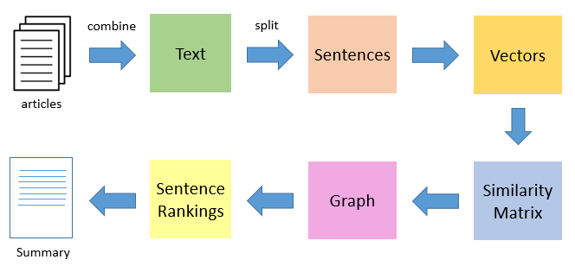
Workflow
Text preprocessing
Applying TextRank
Summarization
Workflow of TextRank
Source: https://www.analyticsvidhya.com/blog/2018/11/introduction-text-summarization-textrank-python/

Slide 13
Benefits of Using TextRank
Address unstructured data
No dependency on keywords by eliminated the need for manually defined terms -> ensuring the broader capture of relevant concepts

Slide 14
Assessing Model Performance: TextRank
ROUGE: Comparing computer-generated summaries to reference summaries written by humans (in this project, healthcare professional) to measure the accuracy and similarity of the summarization.
ROUGE Metric Scoring:
ROUGE-N – Measures the overlap between the computer-generated summary and the reference summary.
ROUGE-1: Single word (Unigram) overlap
ROUGE-2: 2 word (Bigram) overlap
ROUGE-L – Measures the longest common subsequence (LCS) between the generated summary and reference summary for comparison
Score range: 0.0-1.0
Perfect score: 1.0

Slide 15
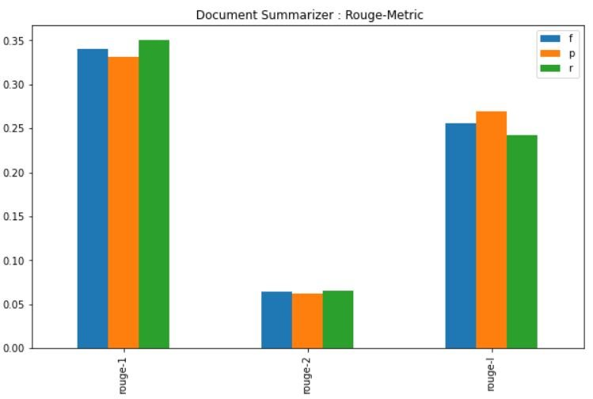
Assessing Models Performance:
ROUGE metric example
Mehta, Ashwinee & Sanikommu, Bhargavi. (2022). Extractive Document Summarization. 10.13140/RG.2.2.23249.40804.

Slide 16
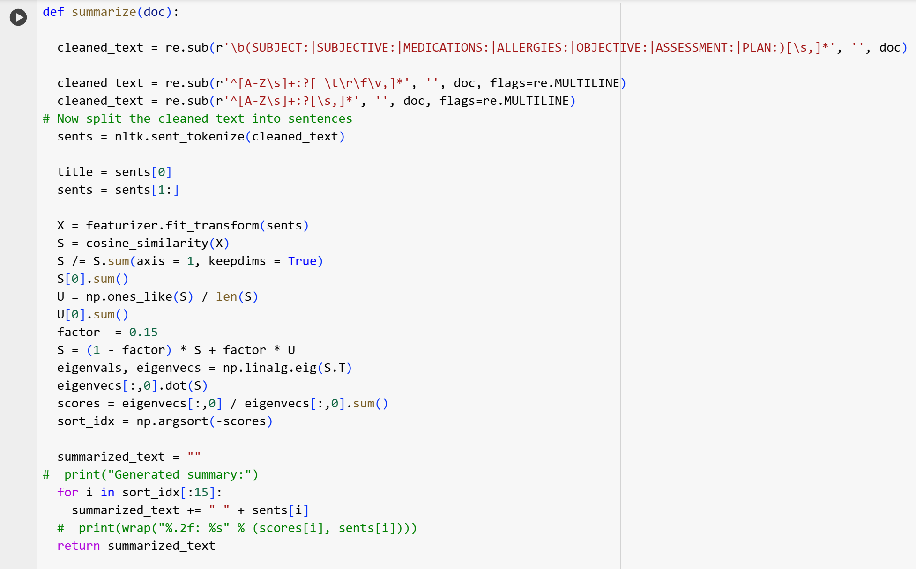
Results (Generated Summaries) TextRank
Clean text
Split into sentences
Calculate cosine similarity
Build graph
Apply model
Return top 15 most important sentences

Slide 17
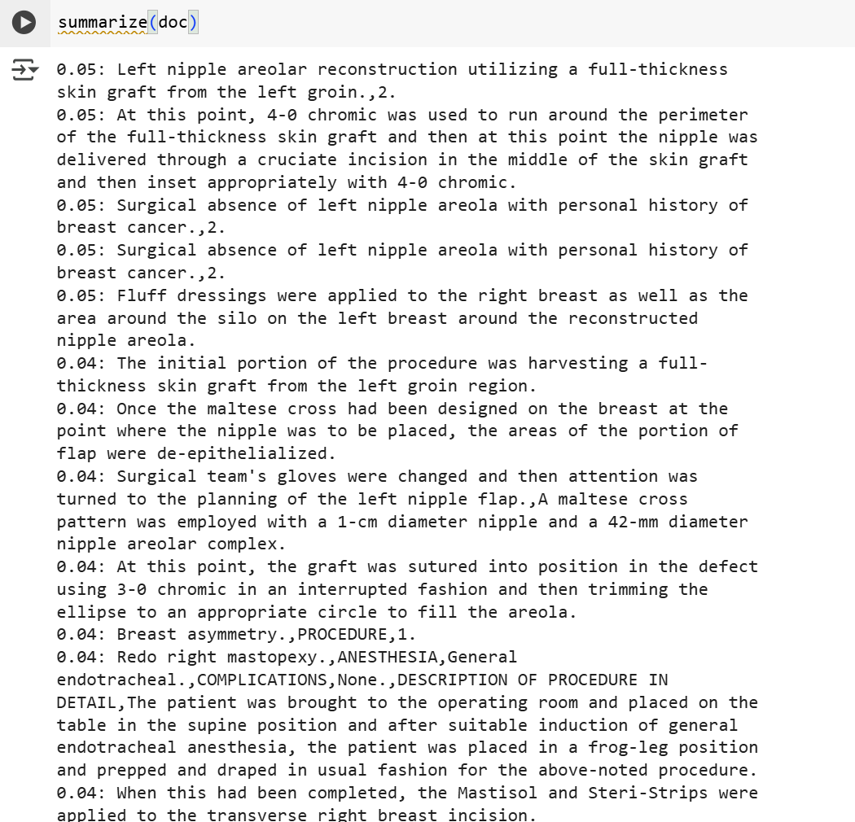
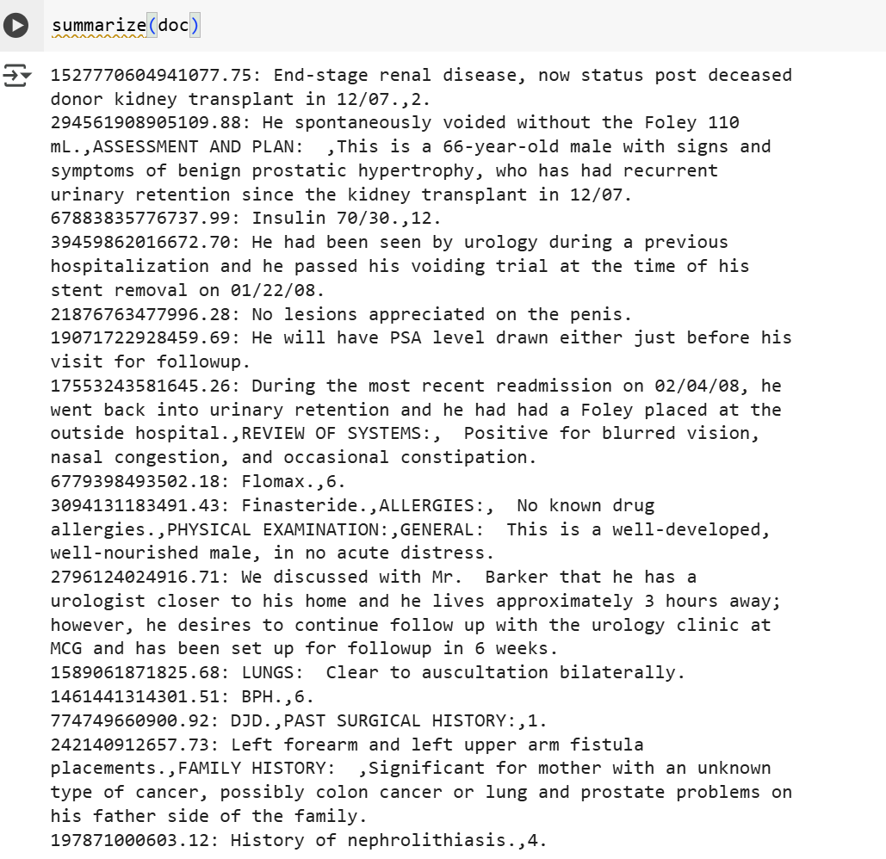
Results (Generated Summaries) TextRank

Slide 18
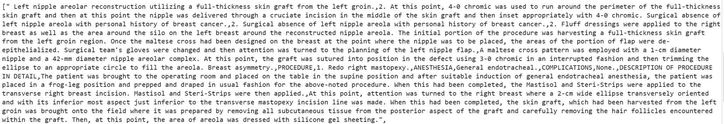
Results (Generated Summaries) TextRank Cont.

Slide 19
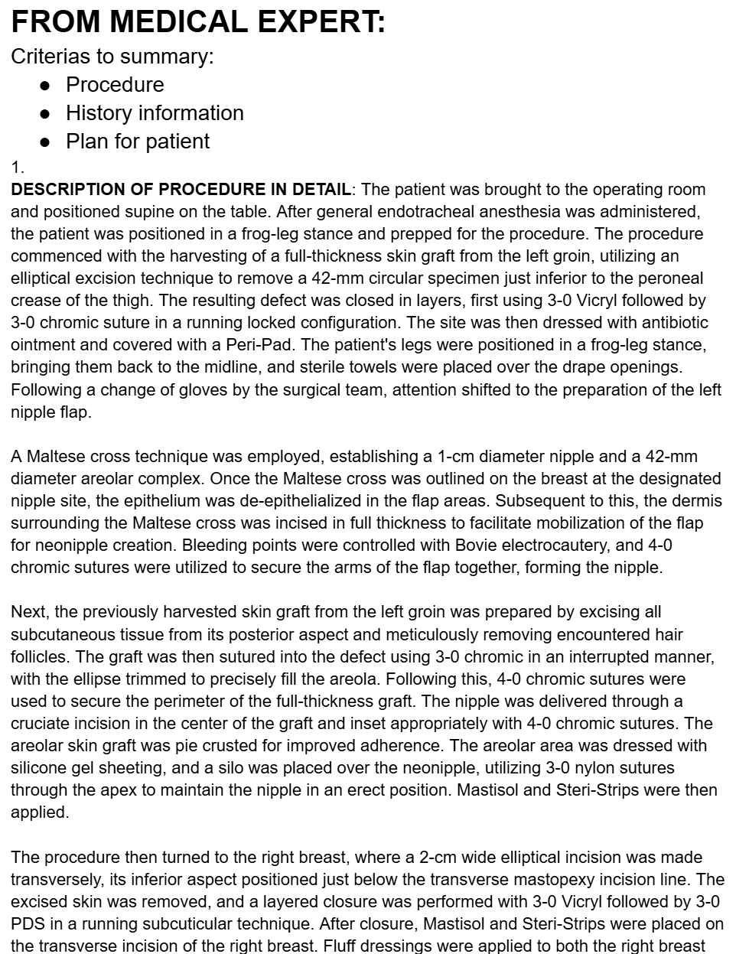
ROUGE Evaluation Model (TextRank)
Gold standard:
Summaries from our medical expert

Slide 20
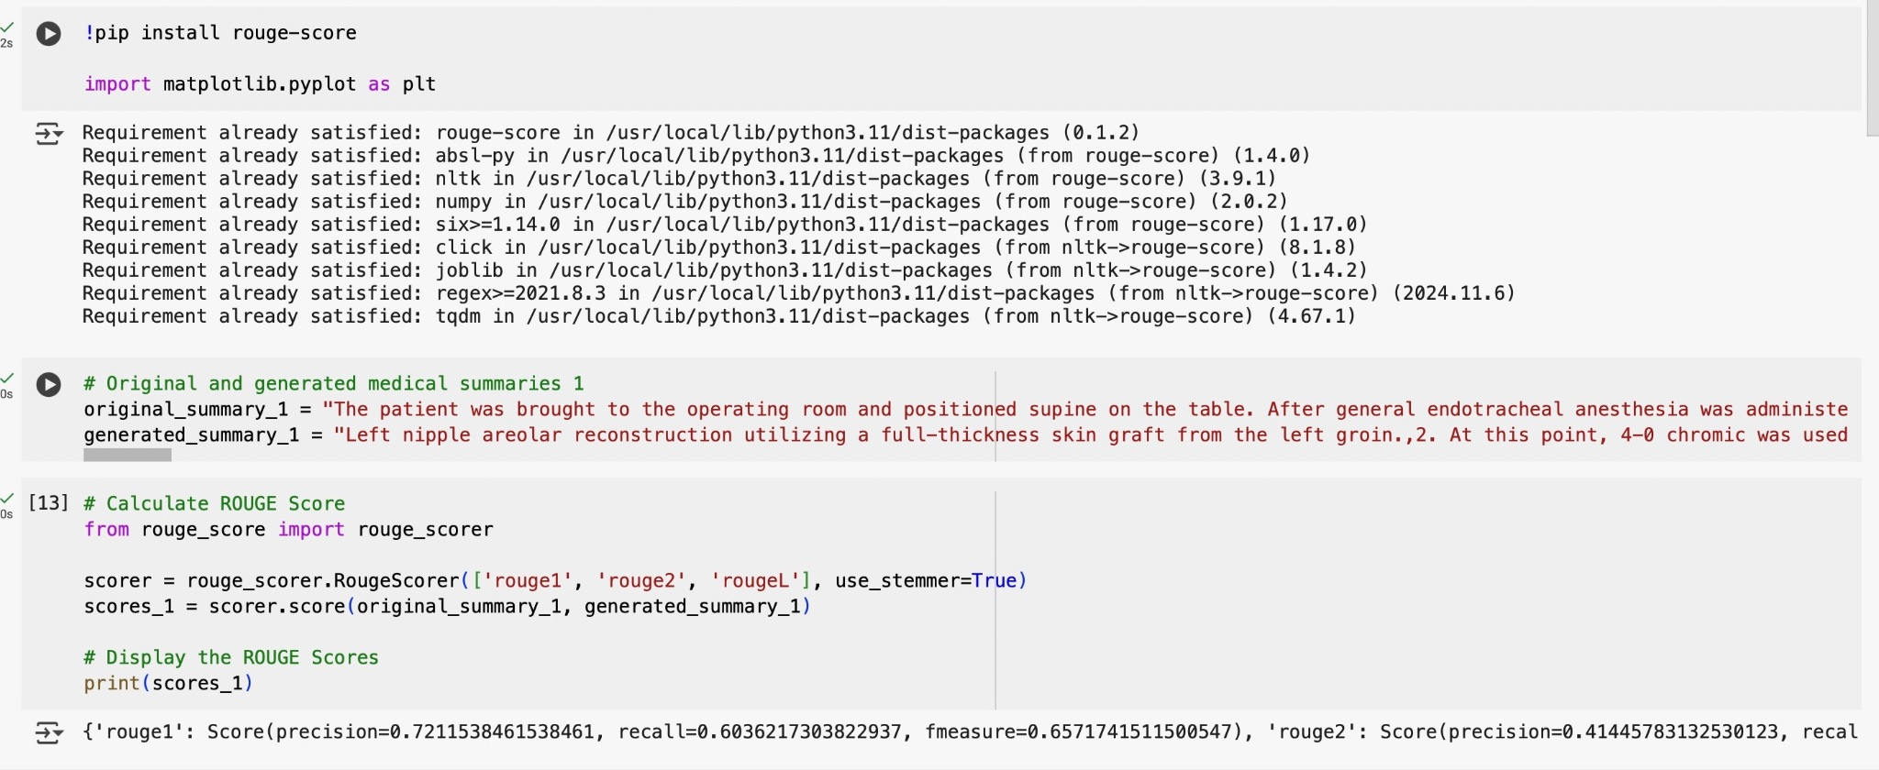
ROUGE Evaluation Model (TextRank)

Slide 21
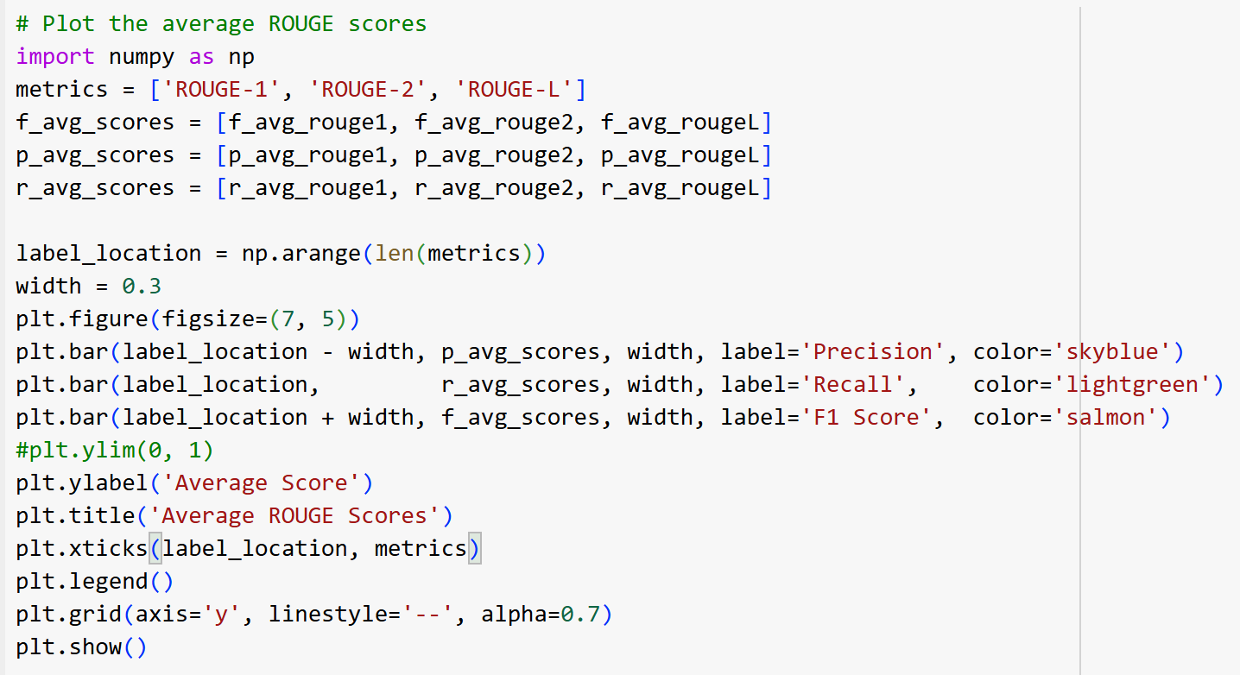
Visualization of Average Scores (TextRank)

Slide 22
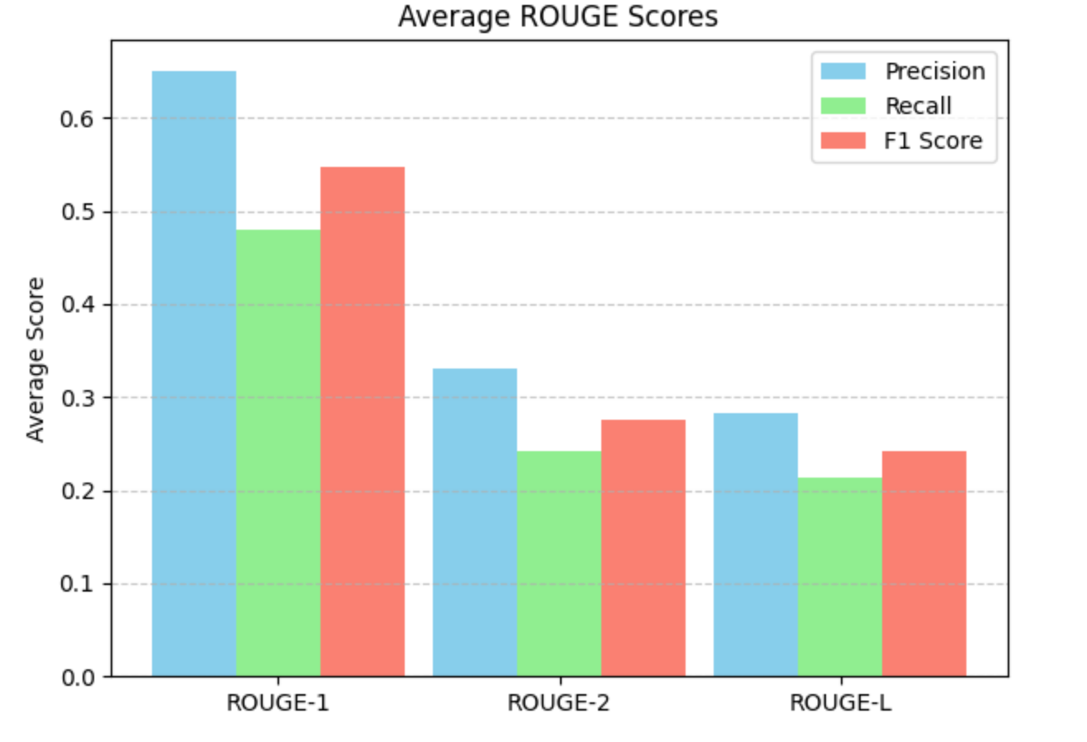
Visualization of Average Scores (TextRank)

Slide 23
Precision Score Analysis:
The Precision score is the proportion of words in the generated summary that are also in the reference summary.
Average ROUGE-1 P1: 0.6507
Unigram (single word) overlap = 65.07%
Average ROUGE-2 P1: 0.3309
Bigram (2 word) overlap = 33.09%
Average ROUGE-L P1: 0.2833
Longest Common Subsequence (LCS) = 28.33%

Slide 24
Recall Score Analysis:
The Recall score is proportion of words in the reference summary that are also in the generated summary.
Average ROUGE-1 R1: 0.4804
Unigram (single word) overlap = 48.04%
Average ROUGE-2 R1: 0.2413
Bigram (2 word) overlap = 24.13%
Average ROUGE-L R1: 0.2140
Longest Common Subsequence (LCS) = 21.40%

Slide 25
F1 Score Analysis:
The F1 Score balances both the precision and recall scores using the harmonic mean.
Average ROUGE-1 F1: 0.5467
Unigram (single word) overlap = 54.67%
This indicates that the generated summaries captured a large amount of key words from the original summaries.
Average ROUGE-2 F1: 0.2761
Bigram (2 word) overlap = 27.61%
ROUGE-1 scores are typically lower than ROUGE-1 as bigrams are harder to match.
This indicates a moderate level of matching phrases between the generated and original summaries.
Average ROUGE-L F1: 0.2411
Longest Common Subsequence (LCS) = 24.11%
This indicates that the generated summaries moderately matched the sentence structure of the original summaries.

Slide 26
Limitations
ROUGE Metric Limitations:
Lexical overlap: ROUGE only looks for words or n-grams and does not understand the meaning of the text.
Extractive/longer summaries are preferred as they preserve original words and phrases. This can cause abstractive/paraphrased summaries to receive lower scores, despite having accurate information.
Scoring can vary based on the gold standard as each medical professional has a unique style of summarizing data.
ROUGE does not score grammar or punctuation which can cause poorly written summaries to receive higher scores.

Slide 27
Proposed Methodology:
II. Scispacy
After summarizing the medical text using TextRank
Scispacy (an extension built on top of Spacy) is trained on biomedical text
-> focuses on biomedical and scientific texts.

Slide 28
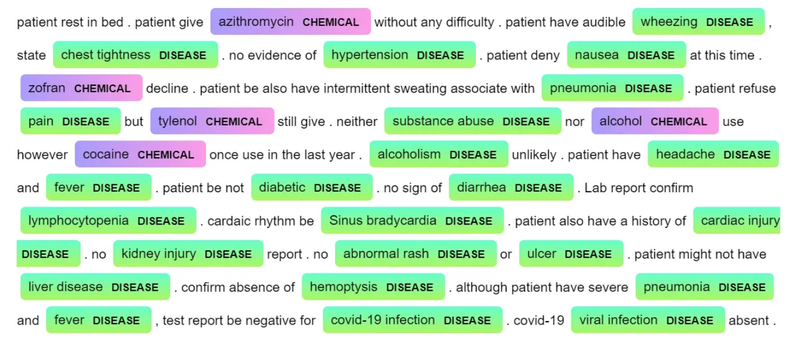
Problem 3: Lack of domain specific awareness
How Scispacy addresses?
Detect and extract named entities such as diseases, chemicals
Specifically recognize medical terminology using NER tags
Add domain specific awareness to the summaries
Example:
Source: https://medium.com/@MansiKukreja/clinical-text-negation-handling-using-negspacy-and-scispacy-233ce69ab2ac

Slide 29

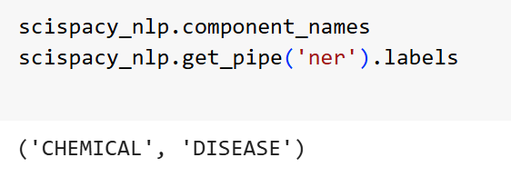
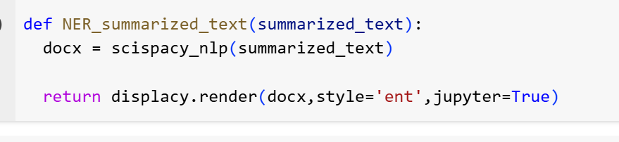
Results (NER) Scispacy

Slide 30
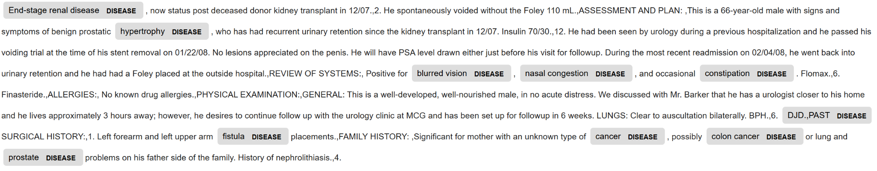
Results (NER) Scispacy

Slide 31
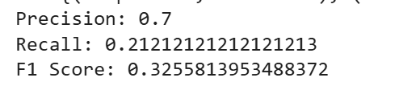
Evaluate Model Scispacy
Finding:
High precision=> most of the identified entities in the summary are correct.
Low recall => a loss in term coverage, which is especially critical in medical contexts where completeness matters.

Slide 32
Limitations:
TextRank is extractive purely
=> generating summaries that may lack of coherence
Typo errors and noisy data still present in the output
=> post-processing step is essential
Evaluation process: This project focuses on developing and demonstrating the workflow of the entire process, rather than statistically proving its effectiveness
=> collaboration with more medical experts to generate high quality reference summaries is essential

Slide 33
Findings From Our Method:
Based on the low score of recall from Scispacy model
=> TextRank helps reduce noise and focuses on key sentences,
but it also removes some essential biomedical entities that the summarization algorithm doesn't consider central.
Our approach would be ideal for fast or high-precision extraction, (e.g. quick reviews), but not ideal where full coverage is required (e.g. in comprehensive patient history analysis)

Slide 34
Conclusion:
Workflow:
Medical Report => TextRank Summary => Scispacy NER => Biomedical Term Highlighted
The approach in this project offers a transparent pipeline, making it useful and easier for medical professionals to understand why certain contents is prioritized in summary.
It also helps accelerate workflows and assist in medical decision making by providing more reliable information

Slide 35
References:
https://www.epic.com/software/ai/
https://dsce.ibm.com/wizard/watsonx/results/watsonx-health-report-assistant
https://aws.amazon.com/comprehend/medical/
https://pmc.ncbi.nlm.nih.gov/articles/PMC9719781/
https://ieeexplore.ieee.org/stamp/stamp.jsp?tp=&arnumber=9453071
https://papers.ssrn.com/sol3/papers.cfm?abstract_id=4395306
https://www.forbes.com/sites/brucelee/2020/01/13/electronic-health-records-here-is-how-much-time-doctors-are-spending-with-them/
https://ieeexplore.ieee.org/document/10134303
https://www.ibm.com/docs/en/watsonx/saas?topic=metrics-rouge

Slide 36
Thank you

